Slide 1

Sentiment Analysis on Bangla OTT Platform Content using
Machine Learning and Deep Learning Approach
Submitted by
Kutub Uddin
ID: CSE 01806766
&
Joy Dey
ID: CSE 01806698
Under The Supervision of
Mrs. Farzina Akther
Senior Lecturer
Department of Computer Science and Engineering, Port City International University

Slide 2
Contents
Introduction
Motivation
Objectives
Related Works
Methodology
Required Tools
Data Collection
Data Preprocessing
Feature Extraction
Classification Algorithm
Model Evaluation Technique
Experimental Output & Result
Conclusion
Future Work
References

Slide 3
Introduction
The OTT(Over The Top) platform is now the global “new normal” for the media and entertainment industry. As time changes people are gradually moving from television to video streaming platforms like Chorki, Hoichoi Bangla, Binge, Bongo Bd, Bioscope, Banglafix etc.
On social networking sites, people frequently talk about OTT platform movies, web series etc. It is possible to determine whether or not people like such a particular movie or web series by analyzing the sentiment of their comments. However, manually evaluating every single comment is a time-consuming and tedious task. As a result, this research investigates the effectiveness of some machine learning and Deep learning models in analyzing the sentiment of OTT movie, web-series related comments made in Bangla.

Slide 4
Motivation
So far a lot of work has been done on Bengali movies and text, but no work has been done on the content of Bengali OTT Platform.
Sentiment analysis is currently occupying a leading position in the field of research. It is helpful for getting results without wasting time and brain. Sentiment analysis is a process to automatically extricate sentiment or opinion from OTT contents review data.
There are scopes for improving existing work through increasing accuracy and enhancing dataset.

Slide 5
Objectives
The purpose of this thesis is to extract effectiveness of some machine learning and Deep learning models in analyzing the sentiment of OTT content related comments made in Bangla dataset and leveled it 3 classes(positive, negative, neutral).
To help the new viewers in OTT to acknowledge a true description of old viewers and also the sites can upgrade their service or contents through users review.
To build a new Bengali dataset from social media websites comments.

Slide 6
Related works
No | Author | Tittle | Published Year | Result | Limitation
01 | Rumman Rashid Chowdhury,Mohammad Shahadat Hossain, Sazzad Hossain ,Karl Andersson. | Analyzing Sentiment of Movie Reviews in Bangla by Applying Machine Learning Techniques. | (ICBSLP) May 2020 (IEEE) | Dataset : 4000 reviews data were gathered from social media websites. Model : SVM, MNB,LSTM Accuracy: SVM provides the best accuracy of 88.90%. | There has been a limitation of labeled data. Using just two classes (Positive and Negative). Only two features are available (TF-IDF and Count Vectorizer). Fewer models are used. The dataset is relatively small for use in a Deep Learning model.
02 | Nayan Banik, Md. Hasan Hafizur Rahman. | Evaluation of Naïve Bayes and Support Vector Machines on Bangla Textual Movie Reviews. | (ICBSLP) December 2018 (IEEE) | Dataset : Collected 800 reviews data from social networking websites and Bangla Movie Database(BMDb) Model : NB, SVM. Precision : SVM provides the best precision of 0.86. | Extremely little labelled data. Only using two classes (Positive and Negative). Only utilizing 1 Feature (TF-IDF). There are less models used.
03 | Atiqur Rahman, Md. Sharif Hossen. | Sentiment Analysis on Movie Review Data Using Machine Learning Approach. | (ICBSLP) May 2020 (IEEE) | Dataset : Data on 2000 reviews was gathered from social networking sites. Model : BNB, DE, SVM, ME, MNB. Accuracy : Best accuracy was achieved by MNB at 88.5%. | Limited amount of labelled data. Using only 2 Class(Positive and Negative).
6

Slide 7
Related works
No | Author | Tittle | Published Year | Result | Limitation
04 | Saeed Mian Qaisar | Sentiment Analysis of IMDb Movie Reviews Using Long Short-Term Memory | (ICCIS) May 2020 (IEEE) | Dataset : Collected 10000 dataset from Internet Movie Database(IMDb). Model : LSTM. Accuracy : Best accuracy was achieved by LSTM 89.9%. | Using only 2 class(Positive and Negative). Using only 1 Feature(Word Embedding). Fewer model are used.
05 | Abdul Hasib Uddin,Durjoy Bapery,Abu Shamim Mohammad Arif. | Depression Analysis from Social Media Data in Bangla Language using Long Short Term Memory (LSTM) Recurrent Neural Network Technique. | (IC4ME2) July,2019 (IEEE) | Dataset : Collected 5000 data from Twitter. Model : LSTM Accuracy : With lstm size 128,the model generated highest accuracy 86.3% where batch size 25 and epoch no 20. | Stop word removal, stemming these type of preprocessing is not done. Dataset is relatively small to use in Deep Learning model. Data stratification is done to increase accuracy but no standard is maintained to do stratification. This may lead to overlap during data subgrouping. Fewer model are used.
7

Slide 8
Methodology
Preprocessing
Tokenization.
Stopwords and emoji removal.
Removing extra symbols
Removing punctuations
Stemming
Data Collection
Sentiment Label
Feature Extraction using TF-IDF & Countvectorizer for Machine Learning
Word Embedding for Deep Learning
Split into 80% training & 20% testing data
pPResult
Model Evaluation
Classification Algorithm (LR, MNB, SVM, RF, LSTM)
Figure : Methodology

Slide 9
Required Tools
Python
Pandas
NumPy
Matplotlib
Scikit-learn
Keras
Google Colab

Slide 10
Data Collection
We have collected data manually and create a dataset of 7003 Bangla sentences.
Labeled the data manually into three categories (Positive,Negative,Neutral). It contains Positive-3662 sentences, Negative-2261 sentences, Neutral-1080 sentences.
To collect OTT content reviews, we chose online streaming platforms Like Hoichoi, Chorki, Bongo BD, Binge related posts and comments on different groups on Facebook, Youtube, Instagram and Twitter.
At the time of labeling the data (which is confusing) as positive, negative or neutral text, we have taken opinion of 20 people within our friends and supervisor also analyzed the comment section of the post to label it.

Slide 11
Data Preprocessing
Tokenization
Stopwords and emoji removal
Removing extra symbols
Removing punctuations
Stemming

Slide 12




Data Preprocessing
Tokenization:
Before Tokenization:আজকে দেখলাম পুরাই টুইস্ট
After Tokenization: <আজকে>< দেখলাম>< পুরাই>< টুইস্ট>
Stopwords and emoji removal :
["অতএব", "অথচ", "অথবা", "অনুযায়ী“..…] [ 😂😥😡💔😍…..]
Extra symbols removal:
[A, B, C, .......Z; a, b, c,……z] [1, 2, 3, 4,…..0]
Figure : Stopwords , emoji & extra symbols removal

Slide 13
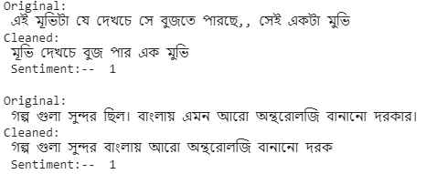
Data Preprocessing
Punctuation character removal :
!#$%^&*(),.?-_+\`·:={}|<>
Stemming:
People are not careful when they are commenting about spelling
Bangla sentences are full of misspelling and incomplete words. Such as: অরথ and অর্থ both are same word.
Stemming find out the root word from the main word
Before Stemming | After Stemming
বাংলাদেশের | বাংলাদেশ
করছিলাম | কর
করছি | কর
Figure : Punctuation character removal & stemming

Slide 14
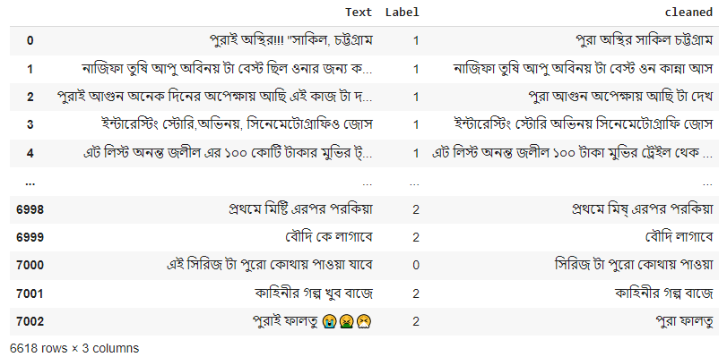
Data Preprocessing
Dataset after cleaning:
Figure : Visualization dataset after cleaning

Slide 15
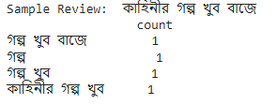
Feature Extraction from the Text : Count Vectorizer
Countvectorizer creates a vocabulary (BOW) of the words in the corpus
Each text reviews converted into a feature vector based on the presence or absence of the terms in the vocabulary(BOW)
Vocabulary :
এসবের | কারণে | সমাজে | এত | খারাপ | কাজ | ফালতু | গল্প | 😡
এসবের | কারণে | সমাজে | এত | খারাপ | কাজ | ফালতু | গল্প | 😡
0 | 1 | 0 | 1 | 0 | 1 | 0 | 0 | 1
Vectorization :
Sample: কাহিনীর গল্প খুব বাজে
Figure : Count Vectorizer Based feature approach

Slide 16
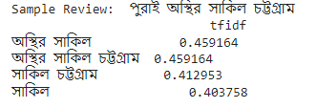
Feature Extraction from the Text : TF-IDF
TF-IDF refers to TF=Term Frequency IDF=Inverse Document Frequency
Also create vocabulary
Counts the frequencies of the words in the status
Each text reviews represent as a vector based on the vocabulary using the following
Formula:
TF(t) = (Number of times term t appears in a document)
(Total number of terms in the document)
(Total number of documents)
TF-IDF = TF(t) * IDF(t)
log
IDF(t) =
(Number of documents with term t in it)
Sample: পুরাই অস্থির সাকিল চট্টগ্রাম
Figure: TF-IDF Based feature approach

Slide 17
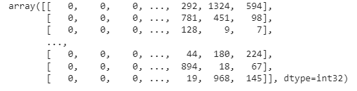
Feature Extraction from the Text : Word Embedding
More semantic representation then Count vectorizer and TF-IDF
Create Vocabulary our vocabulary size=51500
One hot representation: representation of the sentences using word indexes
From vocabulary.
Sample:দিঘী এই একটা গল্পে খুব ভালো অভিনয় করেছে
After preprocessing:দিঘী এক গল্পে ভালো অভিনয় কর
One hot vector representation:দিঘী এক গল্পে ভালো অভিনয় কর=[8527,9012,
2571,523,2560,3676]
Vector representation after pre padding:[0 0 0…2571 523 2560 3673]
Figure : Word Embedding Based feature approach

Slide 18
Classification Algorithm
Conventional Machine learning Model:
Multinomial Nave Bayes (MNB)
Linear Support Vector Machine (SVM)
Random Forest (RF)
Logistic Regression (LR)
Deep learning Model:
Long Short Term Memory(LSTM)

Slide 19
Model Evaluation Technique
TP+TN
TP=True positive
TN=True negative
Accuracy
=
TP+FP+TN+FN
TP
Precision
=
TP + FP
TP
Recall
=
TP + FN
Precision x Recall
F1 Score
=
2
Precision + Recall

Slide 20
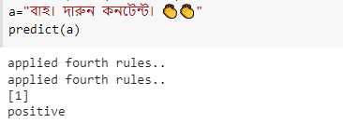
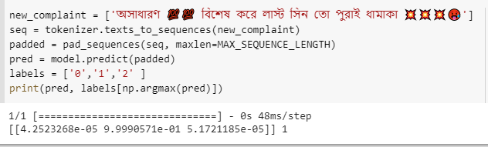
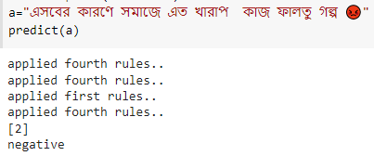
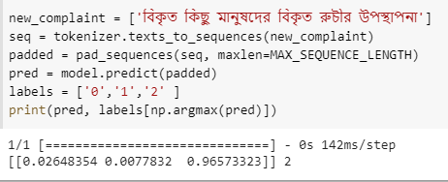
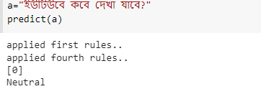
Experimental Output
Figure : Machine learning Model(MNB)
Figure: Deep Learning Model(LSTM)

Slide 21
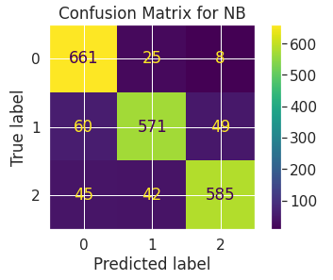
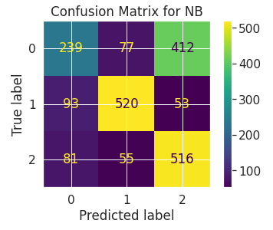
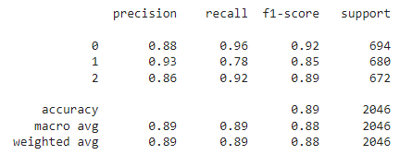
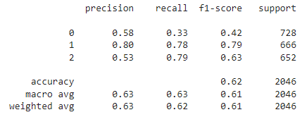
Confusion matrix for Multinomial Nave Bayes Classifier
Experimental result
Figure : Multinomial Nave Bayes Classifier Using TF-IDF feature approach

Slide 22
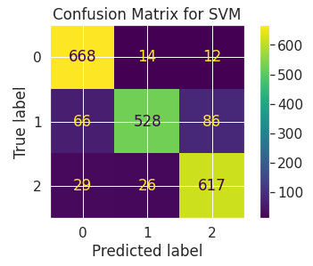
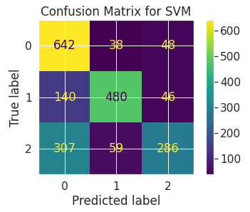
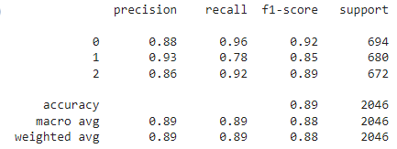
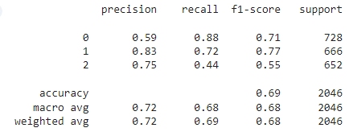
Experimental result
Confusion matrix for Support Vector Machine Classifier
Figure : Support Vector Machine Classifier Using TF-IDF feature approach

Slide 23
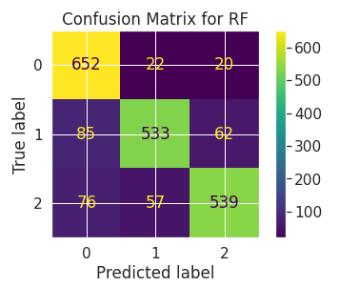
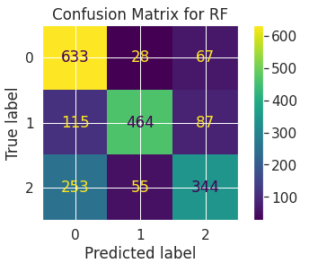
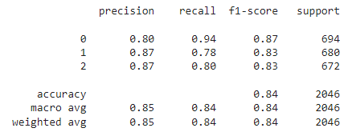
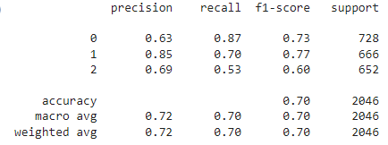
Confusion matrix for Random Forest Classifier
Experimental result
Figure : Random Forest Classifier Using TF-IDF feature approach

Slide 24
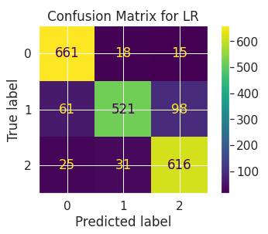
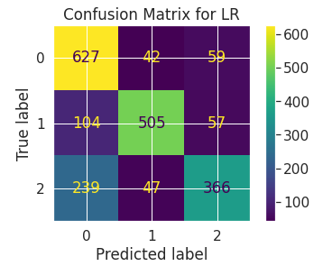
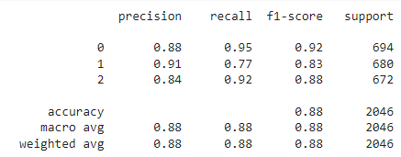
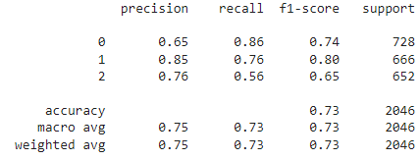
Confusion matrix for Logistic Regression Classifier
Experimental result
Figure: Logistic Regression Classifier Using TF-IDF feature approach

Slide 25
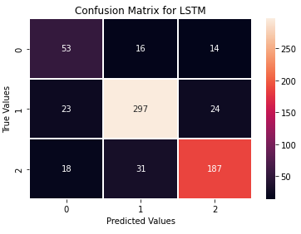
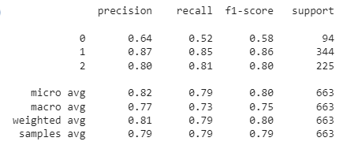
Experimental result
Confusion matrix for Long Short Term Memory Classifier
Figure : Long Short Term Memory Word Embedding Based feature approach

Slide 26
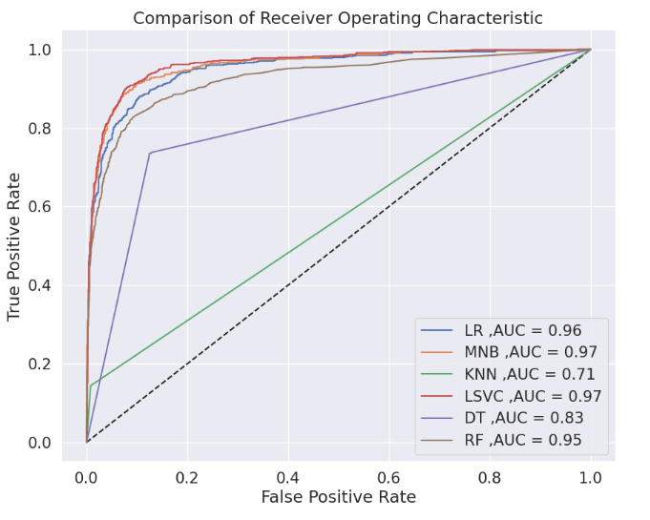
Experimental result
Performance Comparison of All Model Roc-Curve
Features | Algorithm | AUC Score
 | MNB | 0.969524
 | SVM | 0.973930
TF-IDF | RF | 0.952037
 | LR | 0.964276
 | MNB | 0.839189
Count Vectorizer | SVM | 0.862630
 | RF | 0.863262
 | LR | 0.883500
Figure : AUC-ROC curve of overall model performances
26

Slide 27
Experimental result
Performance comparison of different classification algorithms
Features | Algorithm | Accuracy | Precision | Recall | F1-Score
 | MNB | 88.81% | 88.81% | 88.81% | 88.81%
 | SVM | 88.61% | 88.61% | 88.61% | 88.61%
TF-IDF | RF | 84.26% | 84.26% | 84.26% | 84.26%
 | LR | 87.89% | 87.89% | 87.89% | 87.89%
 | MNB | 62.32% | 62.32% | 62.32% | 62.32%
Count | SVM | 68.82% | 68.82% | 68.82% | 68.82%
Vectorizer | RF | 70.43% | 70.43% | 70.43% | 70.43%
 | LR | 73.22% | 73.22% | 73.22% | 73.22%
Word Embedding | LSTM | 81.00% | 82.00% | 79.00% | 80.00%

Slide 28
Conclusion
In this experiment, various techniques were used to identify the polarity of the bangla ott platform content reviews using ML classifiers (MNB, SVM, RF, LR) with TF-IDF and Count Vectorizer based feature extraction techniques and Deep Learning classifiers ( LSTM) with Word Embedding based feature extraction technique applied. Here I have created a dataset of 7003 Bangla sentences by myself and leveled the data into 3 classes(positive, negative, neutral). Through this research work, 89% accuracy is achieved using the MNB classifier and 81% for LSTM model.

Slide 29
Future work
This work can be extended in the following ways in the future:
Increase Labels.
Increase Dataset.
Adding more features.
Adding more Deep Learning Models.

Slide 30
References
[1]Chowdhury, R. R., Hossain, M. S., Hossain, S., & Andersson, K. (2019, September). Analyzing sentiment of movie reviews in bangla by applying machine learning techniques. In 2019 International Conference on Bangla Speech and Language Processing (ICBSLP) (pp. 1-6). IEEE.
[2]Banik, N., & Rahman, M. H. H. (2018, September). Evaluation of naïve bayes and support vector machines on bangla textual movie reviews. In 2018 international conference on Bangla speech and language processing (ICBSLP) (pp. 1-6). IEEE.
[3]Rahman, A., & Hossen, M. S. (2019, September). Sentiment analysis on movie review data using machine learning approach. In 2019 International Conference on Bangla Speech and Language Processing (ICBSLP) (pp. 1-4). IEEE.
[4]Qaisar, S. M. (2020, October). Sentiment analysis of IMDb movie reviews using long short-term memory. In 2020 2nd International Conference on Computer and Information Sciences (ICCIS) (pp. 1-4). IEEE.
[5]Uddin, A. H., Bapery, D., & Arif, A. S. M. (2019, July). Depression analysis from social media data in Bangla language using long short term memory (LSTM) recurrent neural network technique. In 2019 International Conference on Computer, Communication, Chemical, Materials and Electronic Engineering (IC4ME2) (pp. 1-4). IEEE.
[6]Zulfiker, M. S., Kabir, N., Biswas, A. A., Zulfiker, S., & Uddin, M. S. (2022). Analyzing the public sentiment on COVID-19 vaccination in social media: Bangladesh context. Array, 15, 100204.

Slide 31
References
[7]Baid, P., Gupta, A., & Chaplot, N. (2017). Sentiment analysis of movie reviews using machine learning techniques. International Journal of Computer Applications, 179(7), 45-49.
[8]Daeli, N. O. F., & Adiwijaya, A. (2020). Sentiment analysis on movie reviews using Information gain and K-nearest neighbor. Journal of Data Science and Its Applications, 3(1), 1-7.
[9]Hossain, N., Ahamad, M. M., Aktar, S., & Moni, M. A. (2021, February). Movie genre classification with deep neural network using poster images. In 2021 International Conference on Information and Communication Technology for Sustainable Development (ICICT4SD) (pp. 195-199). IEEE.
[10]Haydar, M. S., Al Helal, M., & Hossain, S. A. (2018, February). Sentiment extraction from bangla text: A character level supervised recurrent neural network approach. In 2018 international conference on computer, communication, chemical, material and electronic engineering (IC4ME2) (pp. 1-4). IEEE.
[11]Sarkar, K., & Bhowmick, M. (2017, December). Sentiment polarity detection in bengali tweets using multinomial Naïve Bayes and support vector machines. In 2017 IEEE Calcutta Conference (CALCON) (pp. 31-36). IEEE.
[12]Al-Amin, M., Islam, M. S., & Uzzal, S. D. (2017, February). A comprehensive study on sentiment of bengali text. In 2017 International Conference on Electrical, Computer and Communication Engineering (ECCE) (pp. 267-272). IEEE.

Slide 32
THANK YOU

